Slide 1


TEDI: Teamwork-based education and digitalization as an approach for the interdisciplinary engineering training
The 1st on-line project management meeting
24.09.2024

Slide 2
1st Project Meeting Agenda
Date: Tuesday, 24th September 2024
Place: Microsoft Teams
10:00 - Project presentation by R. Wdowik
10:15 - Discussion on administrative matters by all partners
10:45 - Discussion on work package workload distribution by all partners
11:30 - Conclusions

Slide 3

Crucial areas covered by the TEDI project
International collaboration
Teamwork
Interdisciplinarity
Digitalization

Slide 4



International Collaboration

Slide 5

Teamwork
Team-oriented development of didactic materials
Team-oriented development of training outputs
Team work at all levels of the TEDI project

Slide 6

Interdisciplinarity
Common areas of mechanical and civil engineering
Materials characterization
Alloys, polymers, ceramics, etc.
Measurements of geometrical quantities
Measurements of vibrations
Identification of defects and reliability
Product development in complex systems such as wind turbines, construction machines, tools
Manufacturing and development of machines, tools and construction elements on the basis of mechanical and civil aspects analysis
CAD methodology
CAM methodology
Other computer aided areas methodologies
Procedures regarding safety and work environment conditions
Physics of processes

Slide 7

Digitalization
Digital tools usage
Computer-aided methodologies
On-line learning
Inclusiveness

Slide 8

Main activities of the TEDI project
Preparation of learning contents and dissemination contents
and methodologies
Launching 3 separate pilot trainings that consists of on-line and stationary part
Launching 1 on-line pilot training
Multiplier events organization

Slide 9
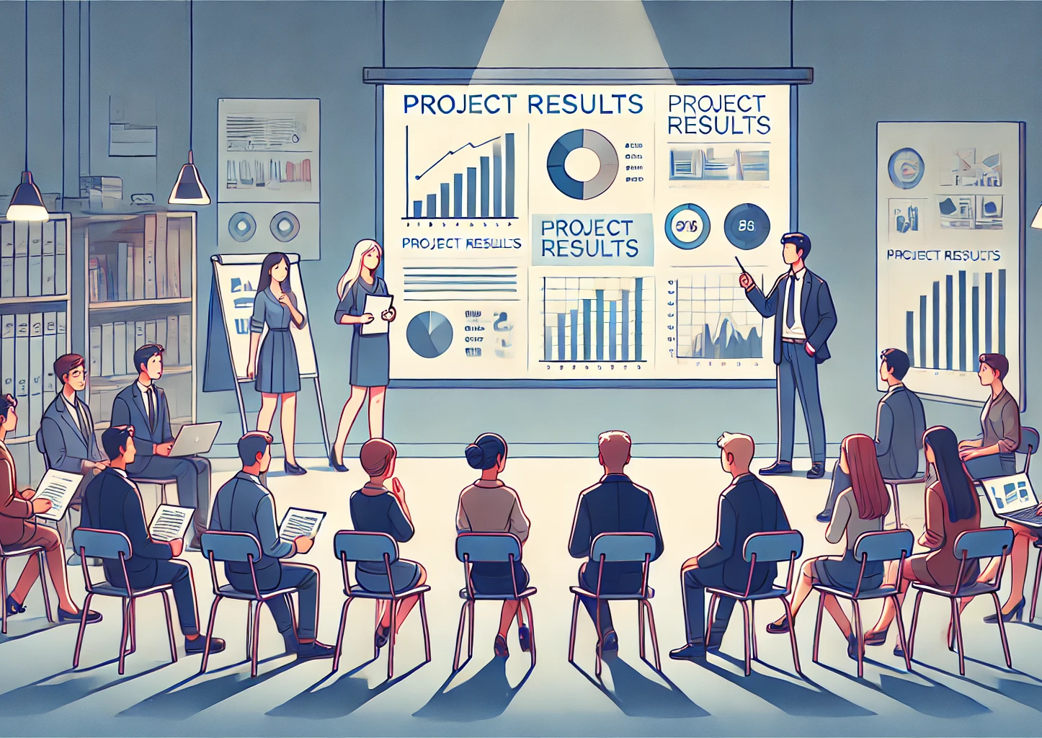
Main results of the TEDI project
An academic book and training materials
E-learning materials developed on the basis of training contents
Presentations, data and results worked out in the trainings
Webpage
Feedback methodology
Multiplier events materials
Newspaper and social media publications

Slide 10

Slide topic (40 points)
Normal text. Normal text.Normal text.Normal text.
Normal text. Normal text.Normal text.Normal text.Normal text.
Normal text. (18 points)
Exemplary points:
An academic book and training materials
E-learning materials developed on the basis of training contents
Presentations, data and results worked out in the trainings
Webpage
Feedback methodology (18 points)
Figure X. Figure caption
Table X. Table caption

Slide 11



Author of the presentation:
Roman Wdowik, PhD, Eng.
rwdowik@prz.edu.pl
More on our webpage: http://tedi.prz.edu.pl
Find us also on:
This presentation contains graphical contents which have been prepared by the use of AI by openai.com. Text has been prepared by the author of the presentation on the basis of the TEDI project proposal statements. Social media logos are shared by their owners.
Funded by the European Union. Views and opinions expressed here are however those of the author(s) only and do not necessarily reflect those of the European Union or the National Agency. Neither the European Union nor The National Agency can be held responsible for them.
Thank you
for your attention!

